Slide 1
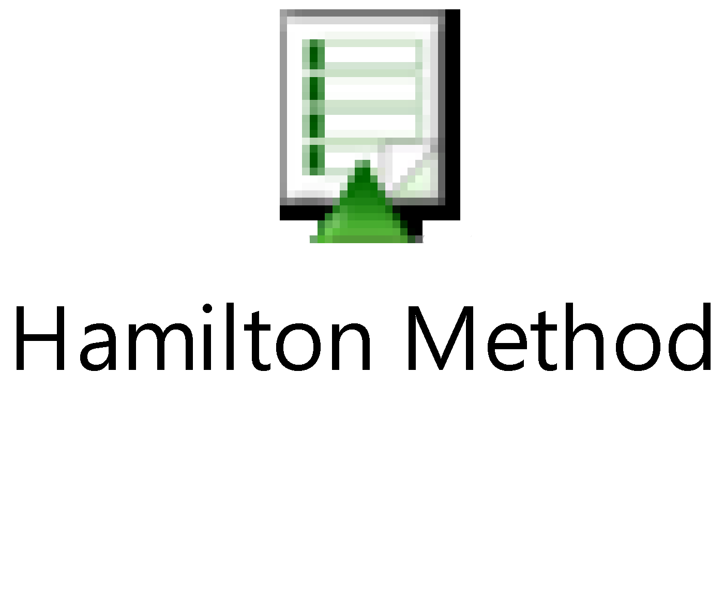
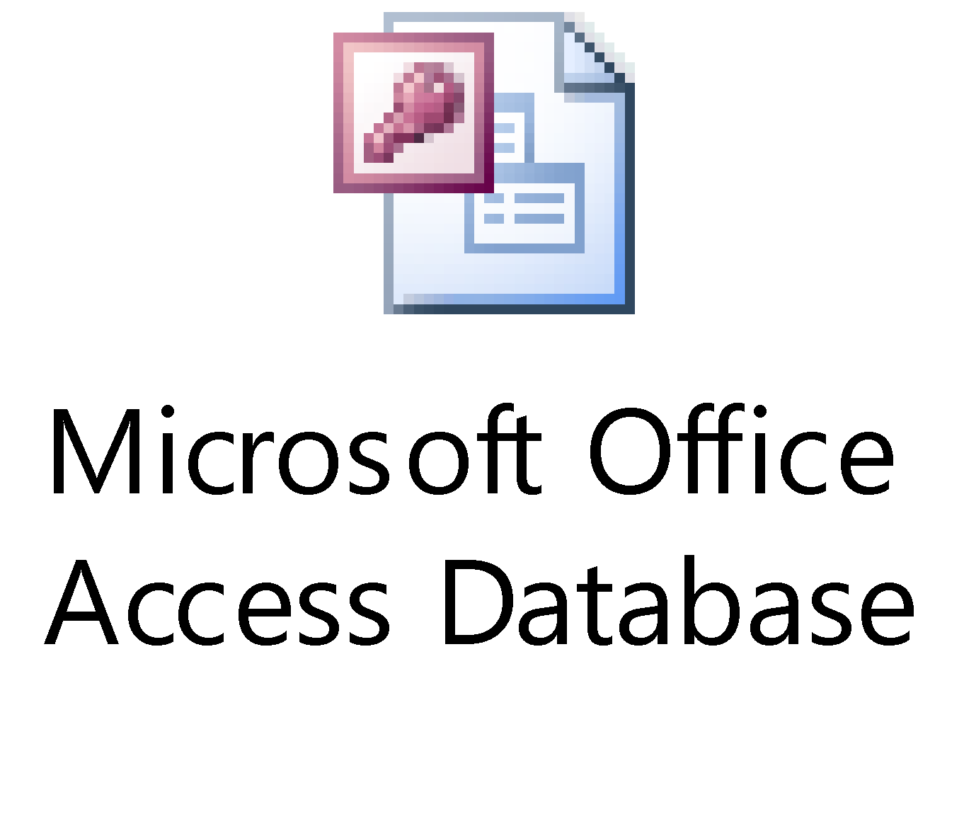

VENUS File Handling SQL Statements & Relational Databases
SQL

Slide 2
Topics
SQL
Syntax
Operators
Select Functions
Aggregate Functions
Other Functions
Relational Databases
Excel vs. Relational Database
Relational Database SQL Functions
Using SQL in Venus File Handling
Examples

Slide 3
What is SQL?
Structured Query Language
The standard language for relational database management systems. SQL statements are used to perform tasks such as updating data on a database, or retrieving data from a database.
Perform calculations
Alter or organize datasets
Return subsets of data
Create new spreadsheets or tables
Merge data from multiple tables (relational database)
Custom Reports
Can be used in Venus file handling commands

Slide 4
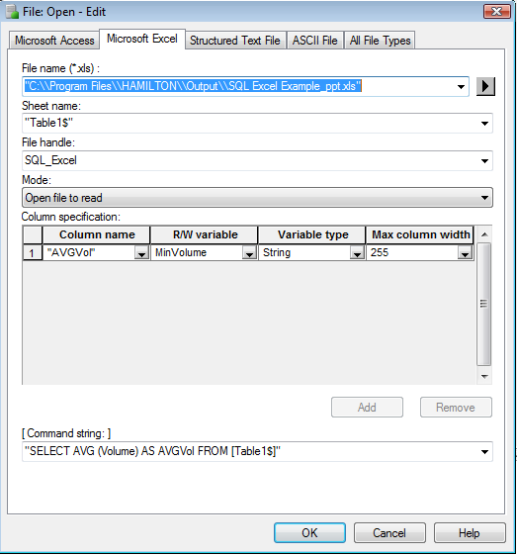
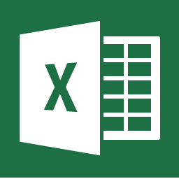
SQL in VENUS

Slide 5
SQL Syntax and Select Functions
Select Data From a Table
SELECT FROM: Select all columns using (*), or specific column headers
SELECT * FROM [Table 1]
SELECT [Column 1], Column2 FROM [Table 1]
Conditionally Select Data From a Table
Mathematical Operators
=, <, >, <=, >=, (!= or <>, not equal)
WHERE
SELECT * FROM [Table1] WHERE Volume = 100
AND/OR
SELECT * FROM [Table1] WHERE Volume <= 100 AND Sample_Barcode = ‘SMP001’
SELECT * FROM [Table1] WHERE Volume <> 100 OR Sample_Barcode = ‘SMP001’
IS/IS NOT NULL
SELECT * FROM [Table1] WHERE Volume IS NOT NULL

Slide 6
SQL Syntax and Select Functions (Cont)
Conditionally Select Data From a Table (Cont)
IN: Select discrete values in a column from a “list”
SELECT * FROM [Table1] WHERE Volume IN (2, 5, 15, 25)
BETWEEN: Select data between two values
SELECT * FROM [Table1] WHERE Volume BETWEEN 100 AND 200
LIKE: Select data that is “like” or contains specified characters
Wildcard characters and ranges can be used: “%”, “_”, [1-5]
SELECT * FROM [Table1] WHERE Volume LIKE ’15%’
SELECT * FROM [Table1] WHERE Plate_Position LIKE ‘A[1-9]’
DISTINCT: Select distinct data from a table that has multiple entries of a specific value in a column
SELECT DISTINCT Plate_Barcode FROM [Table1]
SELECT INTO: Select specific values from one table into another
SELECT Plate_Barcode, Volume INTO [Table2] FROM [Table1]

Slide 7
SQL Aggregate Functions
Perform Calculations on Selected Data From a Table
COUNT(): Count the rows in the selected data of a table
SELECT COUNT (Volume) AS [VolumeCount] FROM [Table1]
SELECT COUNT (Volume) AS [VolumeCount] FROM [Table1] WHERE Sample_Barcode = ‘SMP0001’
MIN(): Return the minimum value in the selected field
MAX(): Return the maximum number in the selected field
SUM(): Return the sum of all values in the selected field
AVG(): Return the average of values in the selected data
STDEV(): Return the standard deviation of values in selected data

Slide 8
SQL Aggregate Functions (Cont)
Return Specific Data From a Data Field
FIRST(): Return the first record in a specified column
SELECT FIRST(Volume) FROM [Table1]
LAST(): Return the last record in a specified column
UCASE(): Return the desired record(s) in upper case
LCASE(): Return the desired record(s) in lower case
NOW(): Return the date and time of the system
LEN(): Return the number of characters (length) in a record
MID(): Return specific characters within a record
SELECT MID(Sample_Barcode, 1, 5) AS SampleBC FROM [Table1]
ROUND(): Round the values in a specified column to a specified number of decimals
SELECT ROUND (Volume, 2) FROM [Table1]

Slide 9
Other SQL Functions
UPDATE: Update specific values in a dataset, without having to “write” an entire row of data
UPDATE [Table1] SET Volume = 120 WHERE Plate_Barcode = ‘PLT001’
UPDATE [LiquidClass] SET AsMixFlowRate = 250 WHERE LiquidClassName = 'StandardVolume_Water_DispenseJet_Empty_SQLTest’
GROUP BY: Used along with an aggregate function to provide means of grouping the result dataset by specified column(s)
SELECT Sample_Barcode, AVG(Volume) AS AvgVol FROM [Table1] GROUP BY Sample_Barcode
ORDER BY: Organize a dataset by sorting the data in ascending or descending order of one or more columns
SELECT * FROM [Table1] ORDER BY Plate_Barcode ASC, Sample_Barcode DESC, Volume ASC
INSERT INTO: Insert specified values into all columns, or specified columns
INSERT INTO [Table1] VALUES (X, Y, Z)
INSERT INTO [Table1] (Column1, Column3) VALUES (X, Z)

Slide 10
SQL Sub-Query Functions
Perform multiple functions at once by querying sub-queries
Count the distinct number of records in a column
SELECT COUNT(*) AS rcdCount FROM (SELECT DISTINCT Plate_barcode FROM [Table1])
Return the sample barcode, average concentration, as well as calculate and return the CV between volumes of replicate samples, grouped by sample barcode
SELECT VolCV, Sample_Barcode, AvgConc FROM (SELECT Sample_Barcode, AvgConc, (StdevVol / AvgVol) AS VolCV FROM (SELECT Sample_Barcode, AVG([Concentration ng/ul]) AS AvgConc, AVG(Volume) AS AvgVol, STDEV(Volume) AS StdevVol FROM [Table1] GROUP BY Sample_Barcode))

Slide 11
Implementing SQL In Venus
Directly input the SQL statement in the “Command String” box of the File Open command
Assemble SQL String Commands As a Variable Using the HSL String Library
SQL query inputs are often variables
File names
Table names
Column names
Search Criteria
HSL String Concatenate commands help assemble input variables with SQL Functions with the right syntax for querying a dataset

Slide 12
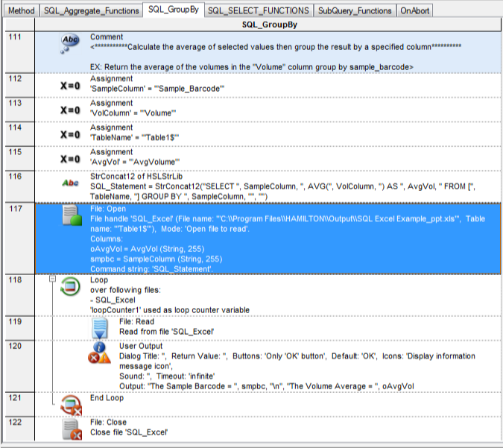
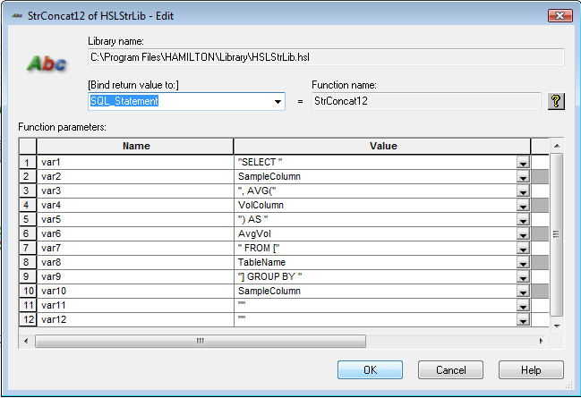
Implementing SQL In Venus

Slide 13
Excel vs. Relational Database
Excel
Spreadsheet application used mostly for storing numerical data
Non-relational Data (Flat)
Internal mathematical calculations through formulas
External mathematical calculations through SQL
Graphing
Ability to use most SQL to query data in spreadsheets
Smaller data capacity (65,536 rows per sheet in Excel 2003)
Relational Database (ex. Access)
Database applications used for the storage of numerical and string data in tables.
Storage of Relational Data
Database Linking
Simultaneous access and updating by multiple users
Larger data capacity
Ability to use SQL to query data from tables, and relational data stored in multiple tables and database files
Mathematical calculations through SQL

Slide 14
When Is A Relational Database Useful?
A need to delete all data from a table (keeping headers)
A need to delete specific records from a table
Dealing with relational data
Example:
Worklist containing sample barcode, dilution factor, LIMS study ID, sample type
Sample Run Table containing individual sample barcodes, plate barcode, and plate position
Plate Run Table(s) with plate barcode, run start date/time, Reagent ‘X’ incubation start, and stop times, STAR Serial #
A need to link databases/tables

Slide 15

When Is A Relational Database Useful?
Ex: Integrated ELISA system with data output,
real-time data handling, and result/run reporting
Ability to link to LIMS databases
Ability to query, calculate, and merge data from related tables and databases
Multiple users update/query data simultaneously
Less files
Larger capacity
All raw data from a source in one database table

Slide 16
Relational Database SQL Functions
DELETE: Delete some or all records from a database table
DELETE * FROM [PlatemapData]
DELETE Plate_Barcode FROM [PlatemapData]
DELETE * FROM [PlatemapData] WHERE Plate_Barcode = ‘B0001’
DELETE [STAR Serial Number] FROM [PlatemapData] WHERE Plate_Barcode = ‘B0001’ OR Sample_Barcode <> ‘SA0007’

Slide 17
Relational Database SQL Functions
Combine relational data from multiple tables located in
the same database file or linked database files using
“SELECT” SQL
No spaces in column headers
Open multiple tables and linked database tables within one Venus file open command
Data extraction based on common table fields
Table 1 Table 2 Table 3
Sample Barcode Plate Barcode Start Time
Sample Name Sample Barcode Plate Barcode
Dilution Factor Plate Position End Time

Slide 18
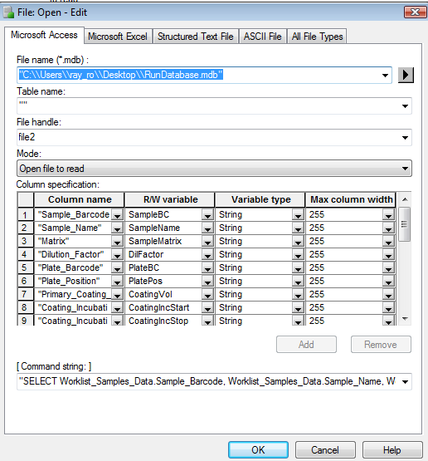
Joining Relational Data In Venus
Place an empty string in the Table Name field of the file open command
Use a SELECT SQL Statement, and identify both the table name and column for selection
SELECT PlatemapData.Plate_Barcode, PlatemapData.Sample_Barcode, PlatemapData.Plate_Position, Sample_Addition_Data.Sample_Addition_Volume WHERE PlatemapData.Plate_Barcode = Sample_Addition_Data.Plate_Barcode
All output data must be “selected”, but can be related through “unselected” criteria
Place selected column names in the “Column Specification” box

Slide 19
Joining Relational Data In Venus
Sub-queries allow the joining of relational data based off
of multiple common fields
Table 1 Table 2 Table 3
Sample Barcode Plate Barcode Start Time
Sample Name Sample Barcode Plate Barcode
Dilution Factor Plate Position End Time
SELECT ‘desired columns from all 3 tables’ FROM Table 1, (SELECT ‘desired columns from table 2 and 3’ WHERE table 2 plate barcode = table 3 plate barcode) WHERE table 1 sample barcode = table 2 sample barcode
Sub-query

